Slide 1

Comparison and Analysis of 3 Key AI documents: EU proposed AI Act, the Assessment List for Trustworthy AI (ALTAI), and ISO/IEC 42001 AI Management System
Delaram Golpayegani^{1,2}, Harshvardhan J. Pandit^{1,3}, Dave Lewis^{1,2}
Email: sgolpays@tcd.ie
GitHub: https://github.com/DelaramGlp/aidocs
¹ ADAPT Centre, Ireland
² School of Computer Science and Statistics, Trinity College Dublin, Ireland
³ School of Computing, Dublin City University, Dublin, Ireland
This project has received funding from the European Union's Horizon 2020 research and innovation programme under grant agreement No 813497.

Slide 2
Current Regulatory Landscape
Multiple AI regulations, standards, and guidelines are being developed separately
!
Highly fragmented landscape → Regulatory and market confusion
There is a need to Identify the commonality, inconsistencies, and gaps across AI documents

Slide 3
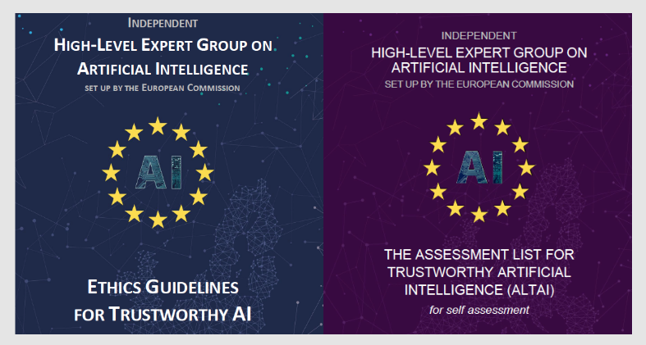
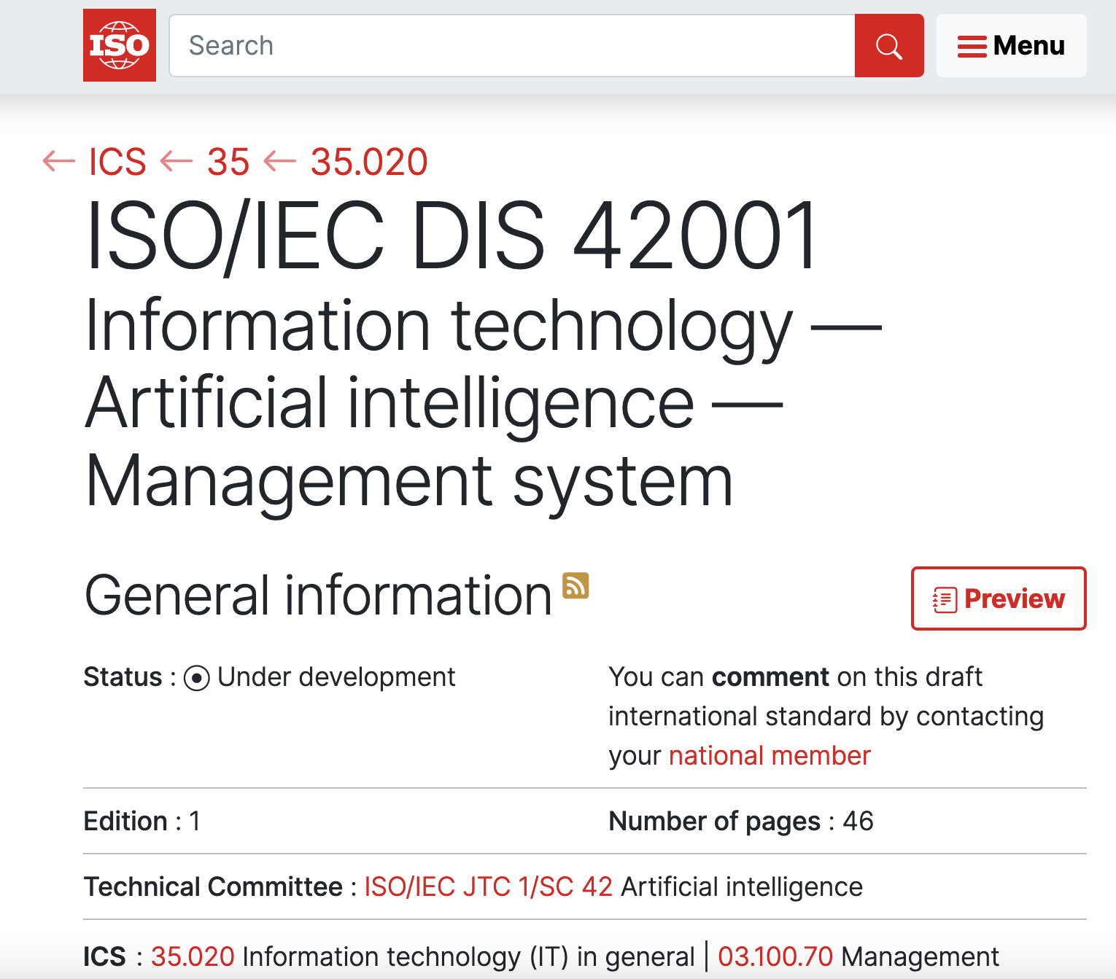
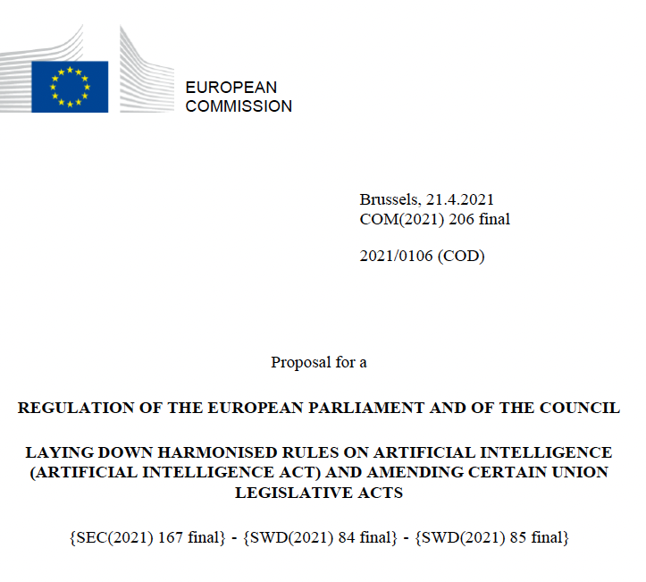
3 Key AI Documents
ALTAI: Assessment List for Trustworthy AI
Questions assessing trustworthy AI requirements
ISO/IEC 42001 AI Management System
Demonstrate management of AI system and AI risk management – certify products and practices
EU’s AI Act: Regulating Artificial Intelligence
Obligations and prohibitions based on high-risk, maintaining documentation

Slide 4
Research Questions
RQ 1. To what extent can
ALTAI’s trustworthy AI requirements
be integrated into ISO/IEC 42001’s AI management system activities?
RQ 2. To what extent can
AI Act’s high-risk AI obligations
be integrated into ISO/IEC 42001’s AI management system activities?

Slide 5
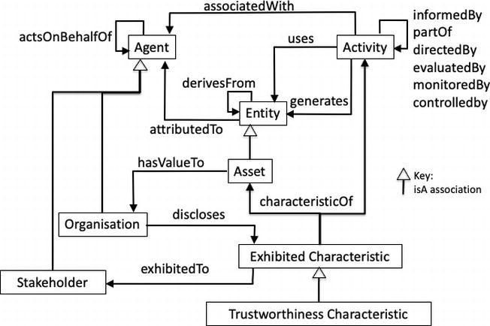
Methodology for Comparison and Analysis
Upper-level ontology for mapping trustworthy AI documents
Steps
1
Document analysis, extraction of trustworthy AI activities and modelling them as Activity
2
Linking activities using partOf relationship
3
Analysis of the overlaps and potential conflicts

Slide 6
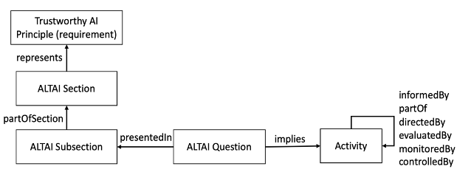
Comparison of ALTAI with ISO/IEC 42001
Extracting activities from ALTAI questionnaire
ALTAI question:
“Are end-users or other subjects adequately made aware that a decision, content, advice or outcome is the result of an algorithmic decision?”
ALTAI activity:
Inform end-users or other subjects that a decision, content, advice or outcome is the result of an algorithmic decision

Slide 7
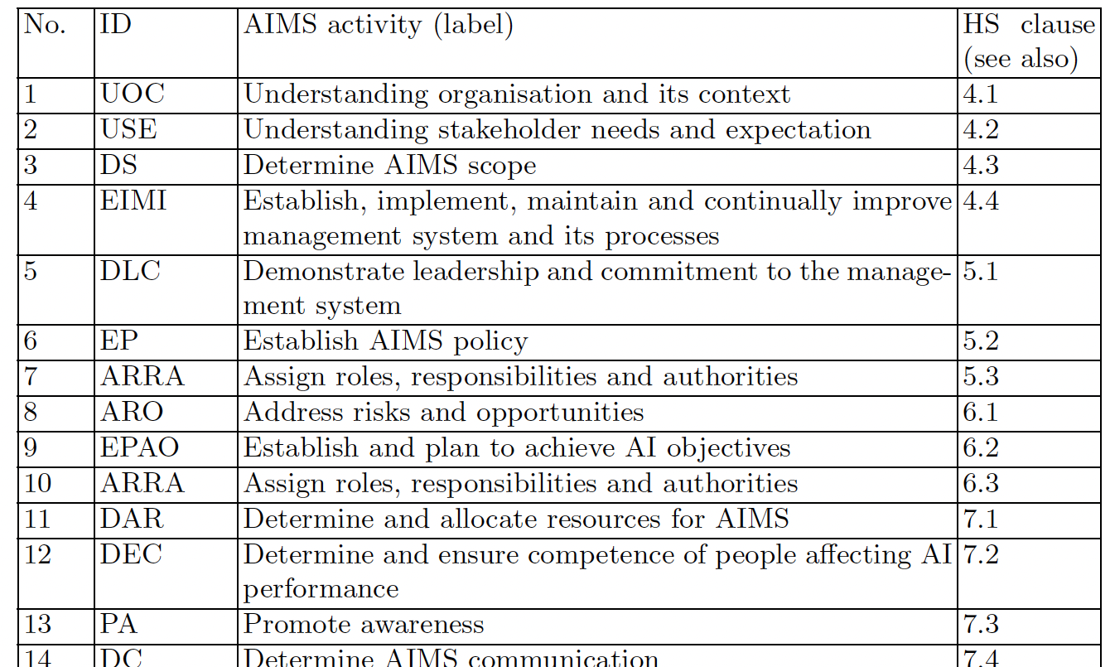
Comparison of ALTAI with ISO/IEC 42001
Identifying AI management system activities from ISO ‘harmonised structure’
for management system standards defined in ISO/IEC Directives on procedures for ISO technical work

Slide 8
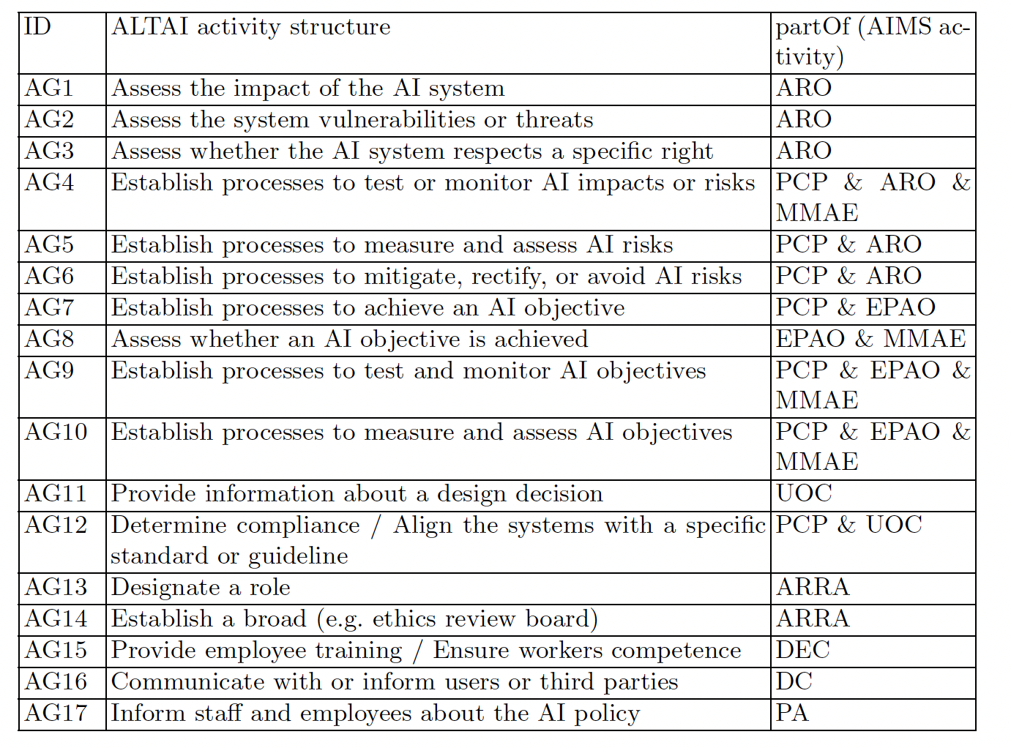
ALTAI – Grouping AI management system activities

Slide 9
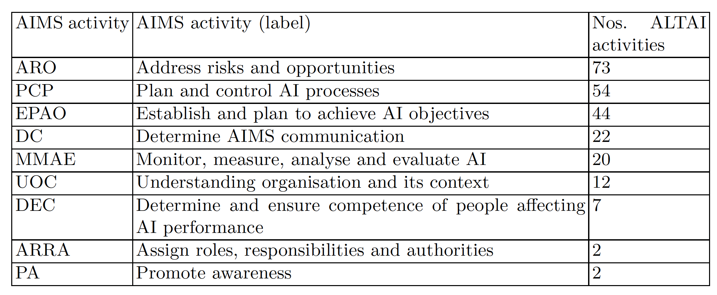
Comparing ALTAI and ISO/IEC 42001
ALTAI adopts a risk-oriented approach for trustworthy AI: ~50% activities relate to risk management

Slide 10
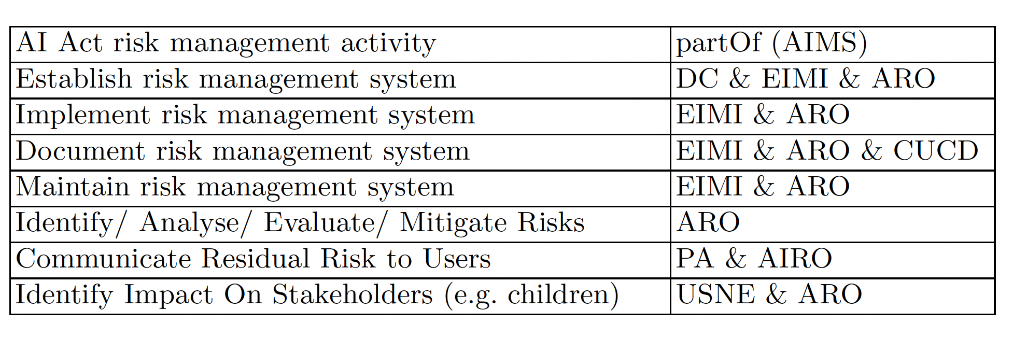
Comparing AI Act with ISO/IEC 42001
Most activities were mapped into:
Establishing management systems,
Addressing risks,
Creating documentation,
Communication with external entities.

Slide 11
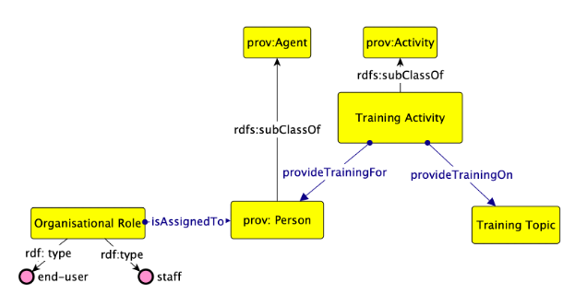
Semantic Modelling of Activities
Modelling relevant ‘patterns’ as as an ontology design pattern (ODP)
Helps systematise “ontologies” by identifying concepts and relations, and expressing compliance information
Ongoing Work
AIRO: an Ontology for Representing AI Risks based on the Proposed EU AI Act and ISO Risk Management Standards.
Delaram Golpayegani*, Harshvardhan J. Pandit, Dave Lewis. International Conference on Semantic Systems (SEMANTiCS, 2022).
https://doi.org/10.3233/SSW220008 AIRO - https://w3id.org/AIRO

Slide 12
Comparison and Analysis of 3 Key AI documents: EU proposed AI Act, the Assessment List for Trustworthy AI (ALTAI), and ISO/IEC 42001 AI Management System
Delaram Golpayegani, Harshvardhan J. Pandit, Dave Lewis
Email: sgolpays@tcd.ie
GitHub: https://github.com/DelaramGlp/aidocs

